Slide 1
Running capstone application application deploy in AWS with Docker and Jenkin

Slide 2
This project present in git repository in below URL
https://github.com/Kaleakash/RunningBankingApp.git
Plz login to virtual lab and clone this project in virtual lab using command as
git clone https://github.com/Kaleakash/RunningBankingApp.git

Slide 3
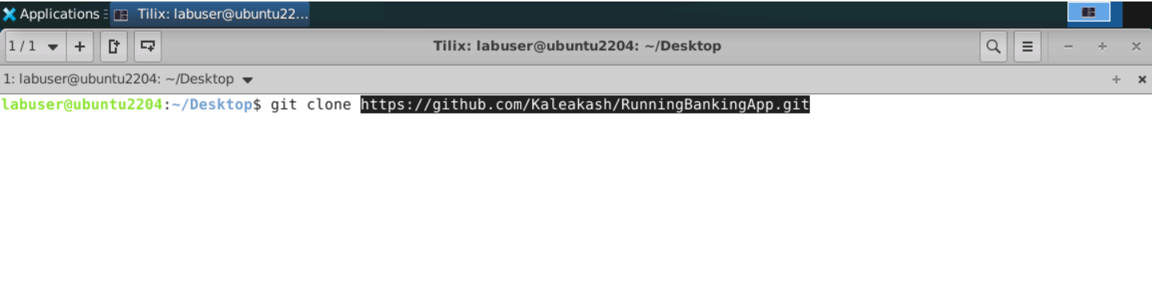
Login the virtual lab and clone the project

Slide 4
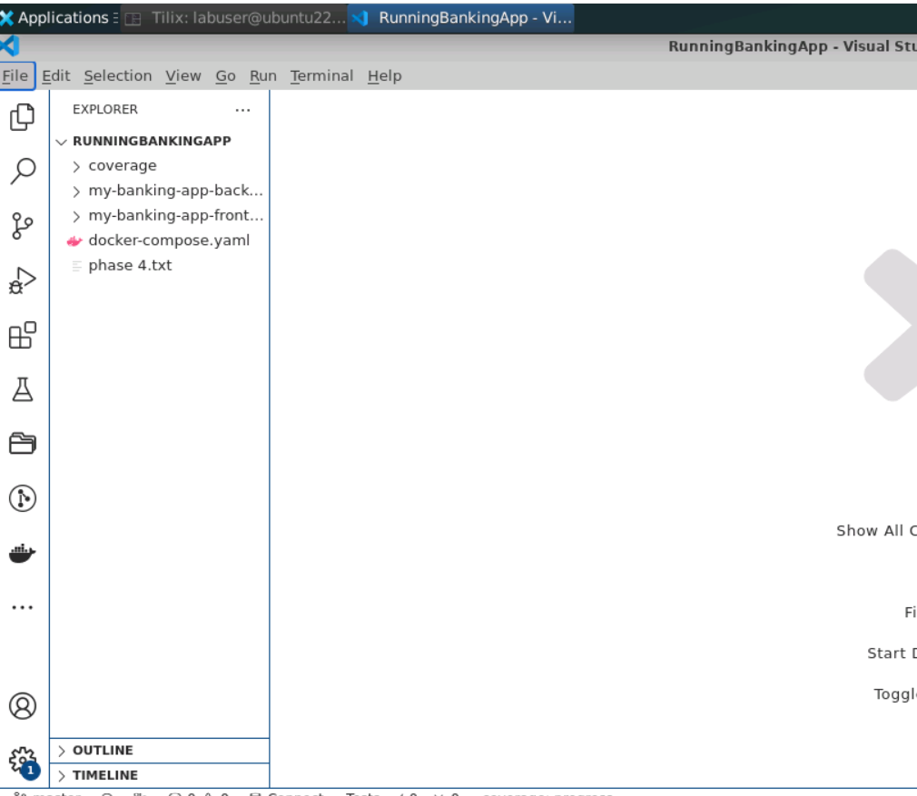
In Virtual lab open this project in VSCode

Slide 5
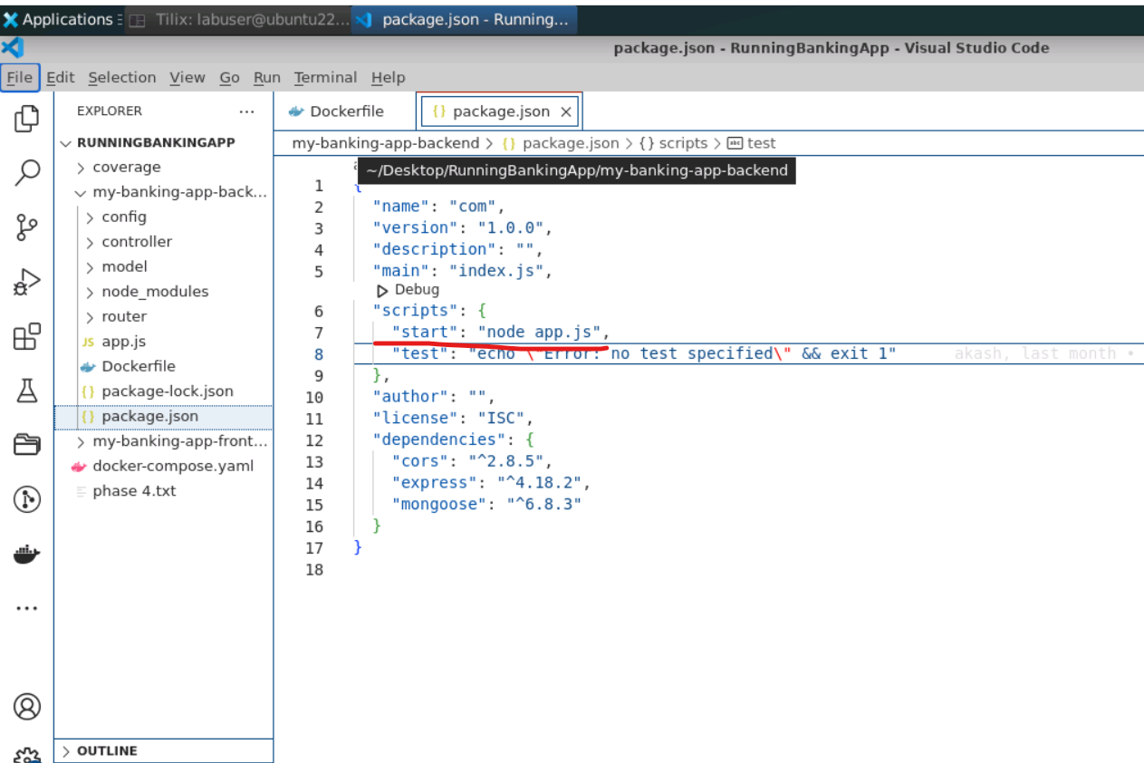
Open the my-banking-app-frontend
In package.json file do the changes

Slide 6
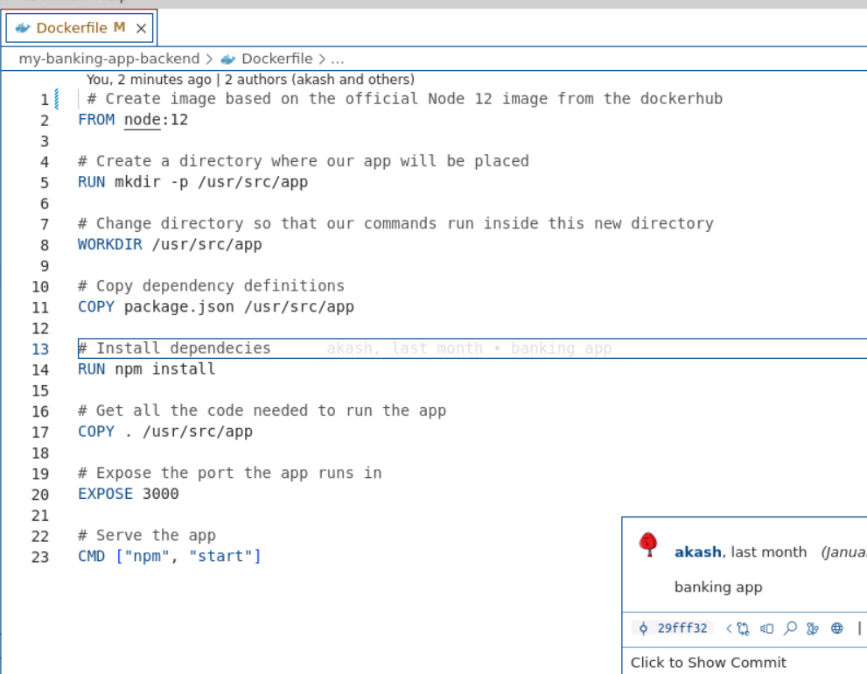
Now we need to create the Dockerfile for backend (express js)
Dockerfile (no extentsion)
# Create image based on the official Node 12 image from the dockerhub
FROM node:12
# Create a directory where our app will be placed
RUN mkdir -p /usr/src/app
# Change directory so that our commands run inside this new directory
WORKDIR /usr/src/app
# Copy dependency definitions
COPY package.json /usr/src/app
# Install dependecies
RUN npm install
# Get all the code needed to run the app
COPY . /usr/src/app
# Expose the port the app runs in
EXPOSE 3000
# Serve the app
CMD ["npm", "start"]

Slide 7
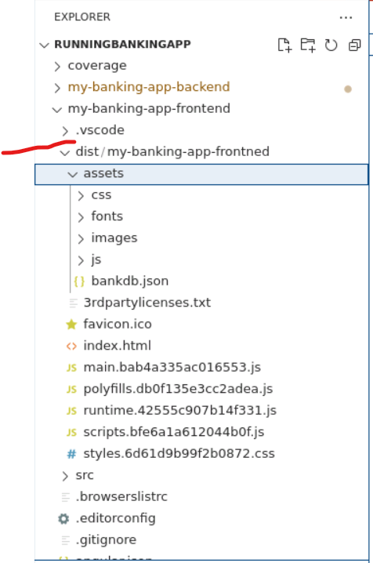
Open the my-banking-app-frontend
We need to build the project
ng build
After build you can see the dist
folder inside a project which
contains all build files.
Now using this dist folder we need to create Dockerfile

Slide 8
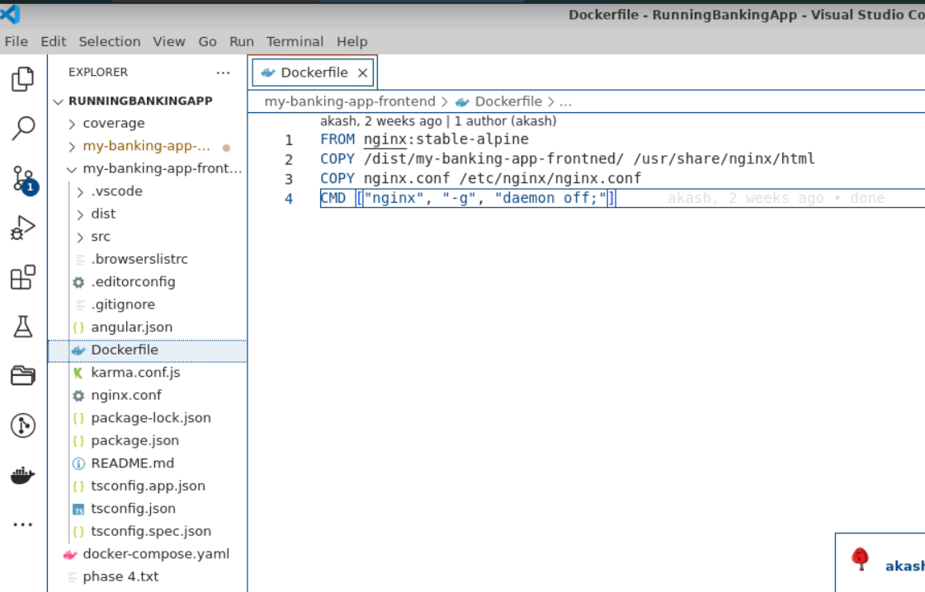
Now we need to create the Dockerfile for frontend (angular)
Dockerfile (no extentsion)
# Create image based on the official Node 12 image from the dockerhub
FROM nginx:stable-alpine
COPY /dist/my-banking-app-frontned/ /usr/share/nginx/html
COPY nginx.conf /etc/nginx/nginx.conf
CMD ["nginx", "-g", "daemon off;"]

Slide 9
Now we need to create the docker-compose file
This file is responsible to create docker images for
Angular project (frontend application)
Backend project (express rest api application)
Mongo db pre defined image which connect with backend project

Slide 10
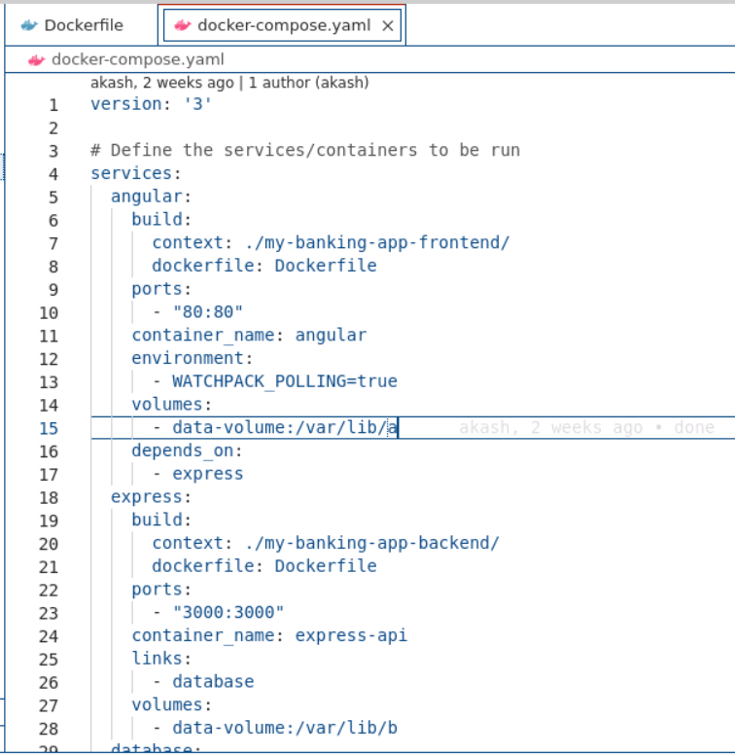

Slide 11
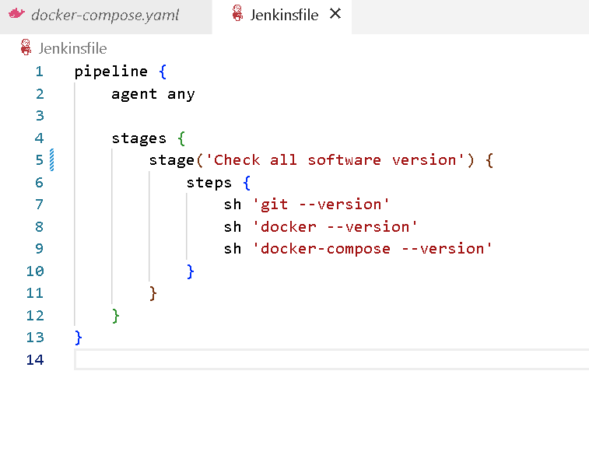
Create Jenkinsfile
As of now this file contains only verify all required software version

Slide 12
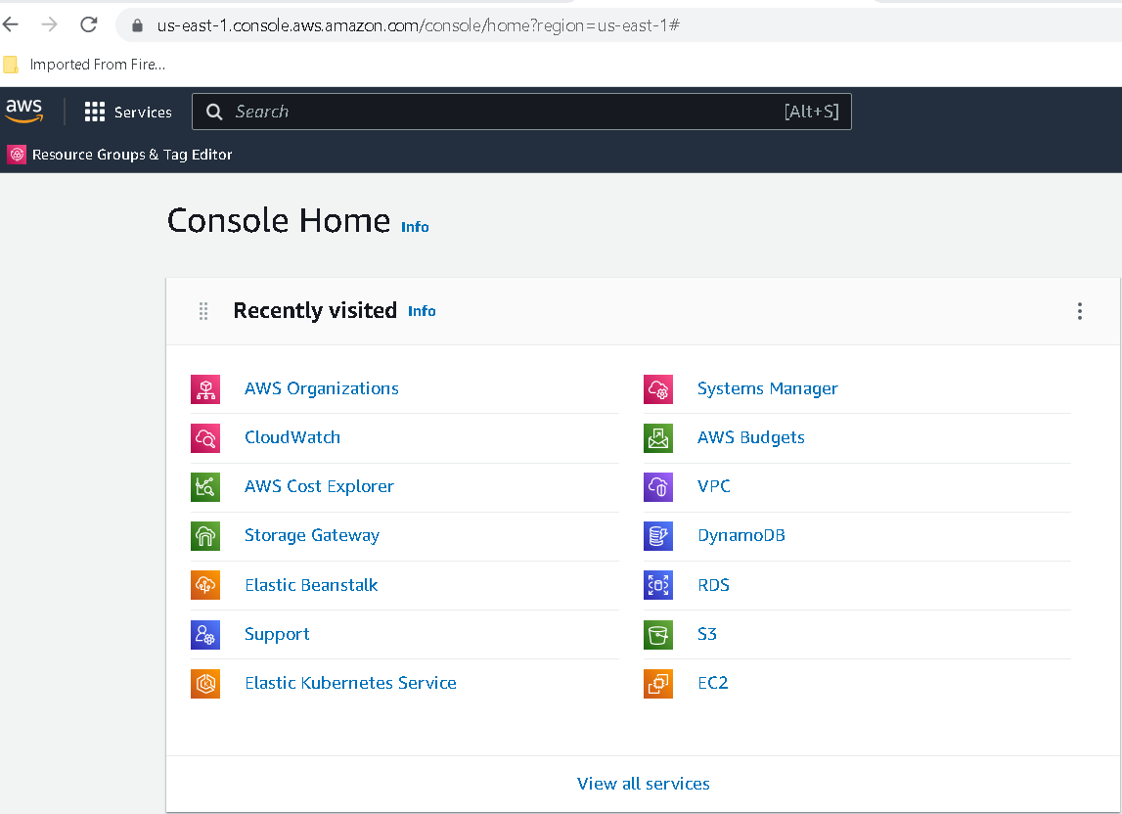
Now we do the login for aws

Slide 13
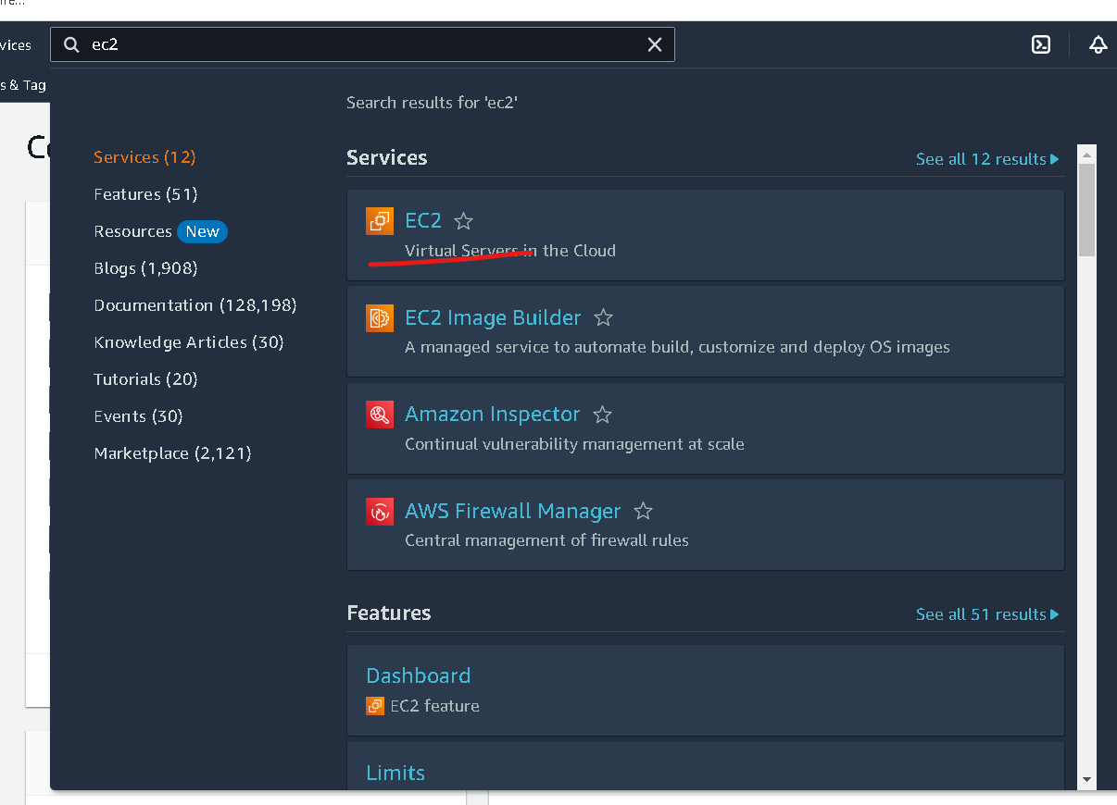
In Search bar search EC2 instance

Slide 14
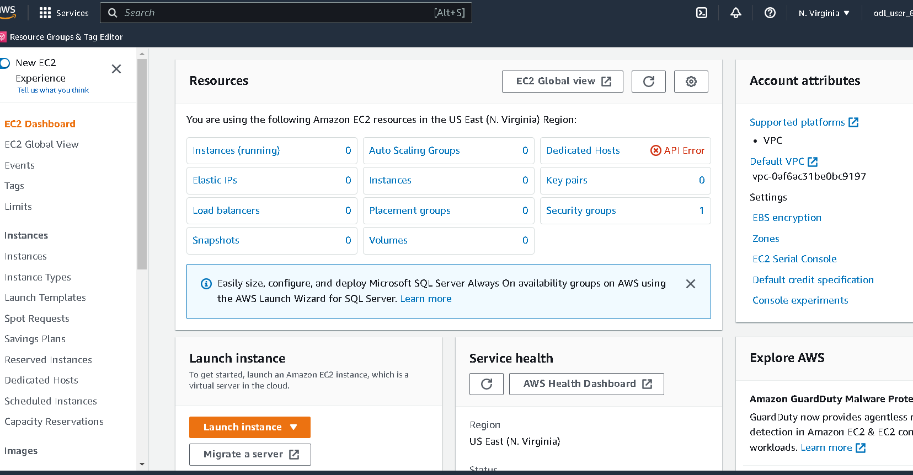

Slide 15
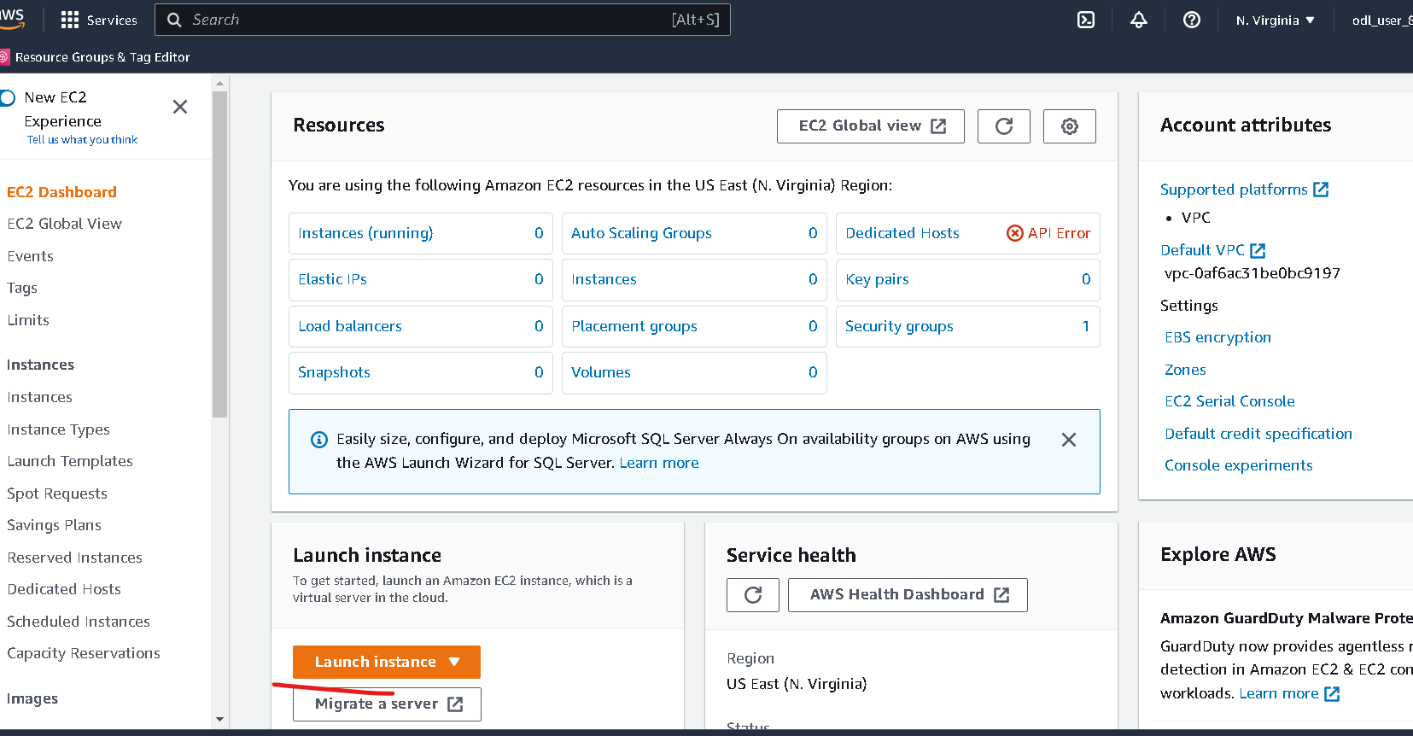
Now you have to click on launch button

Slide 16
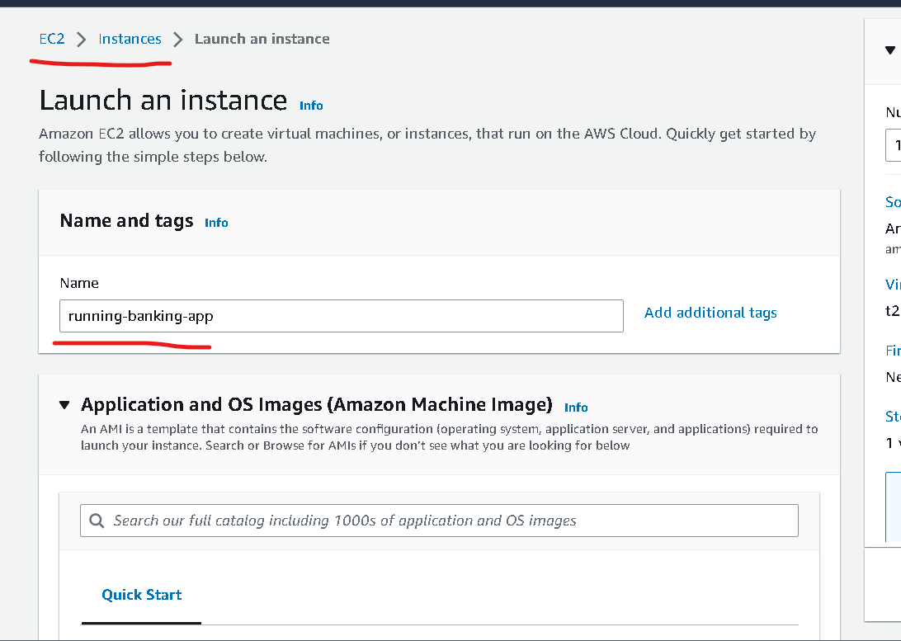
Instance name can be anything :phase2-instance

Slide 17
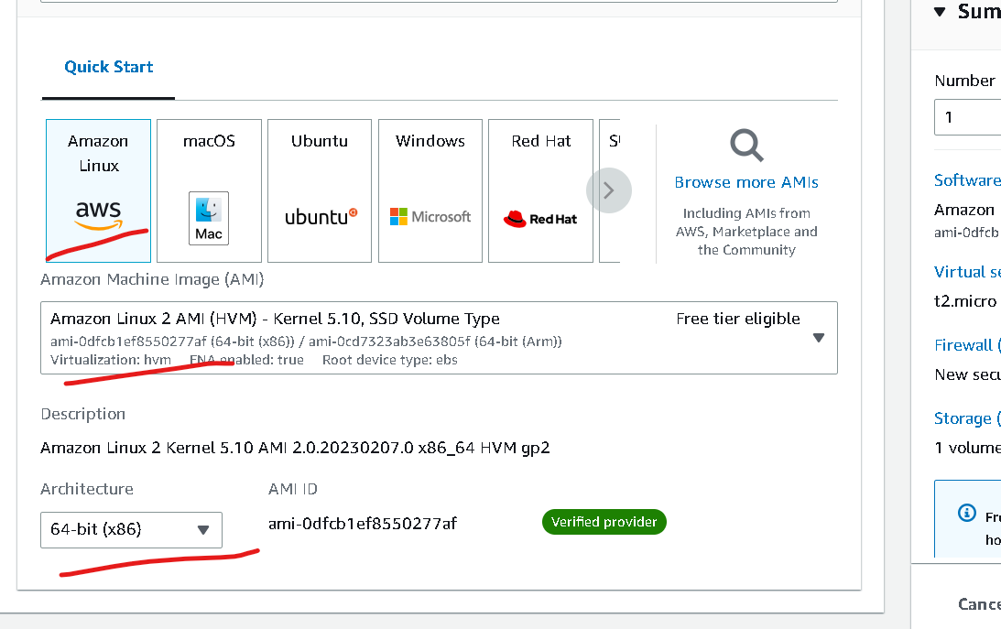
No changes – default option

Slide 18
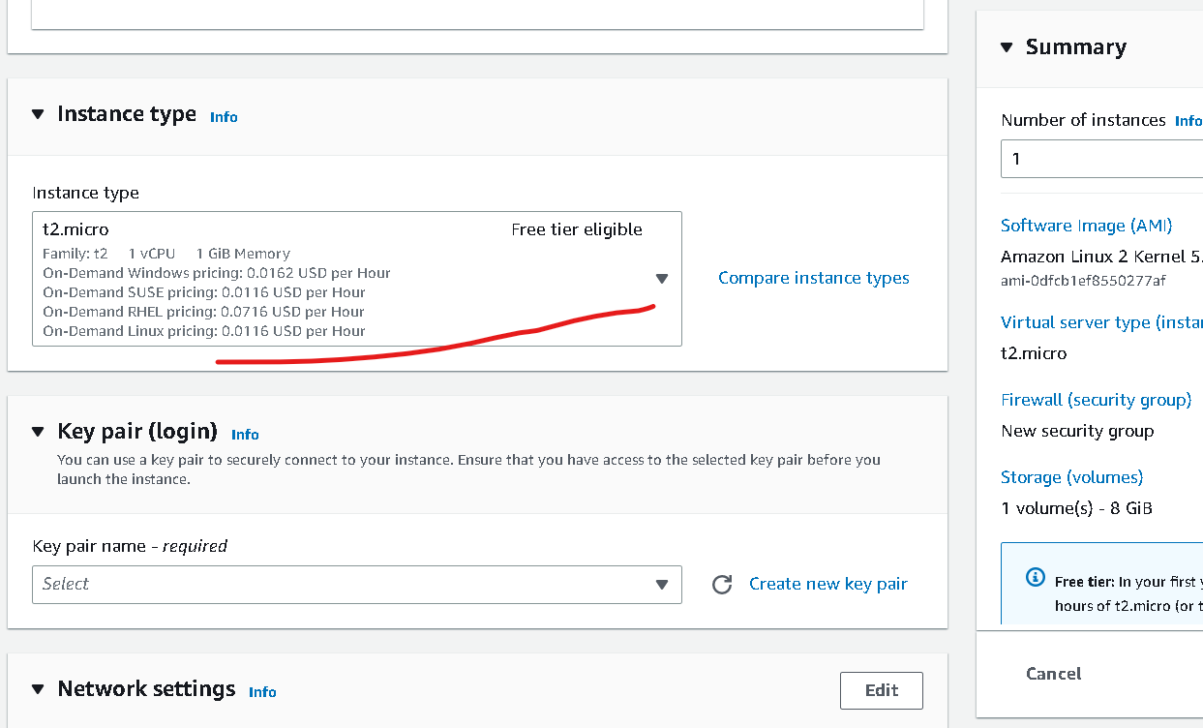
Instance type – free tier (don’t change)

Slide 19
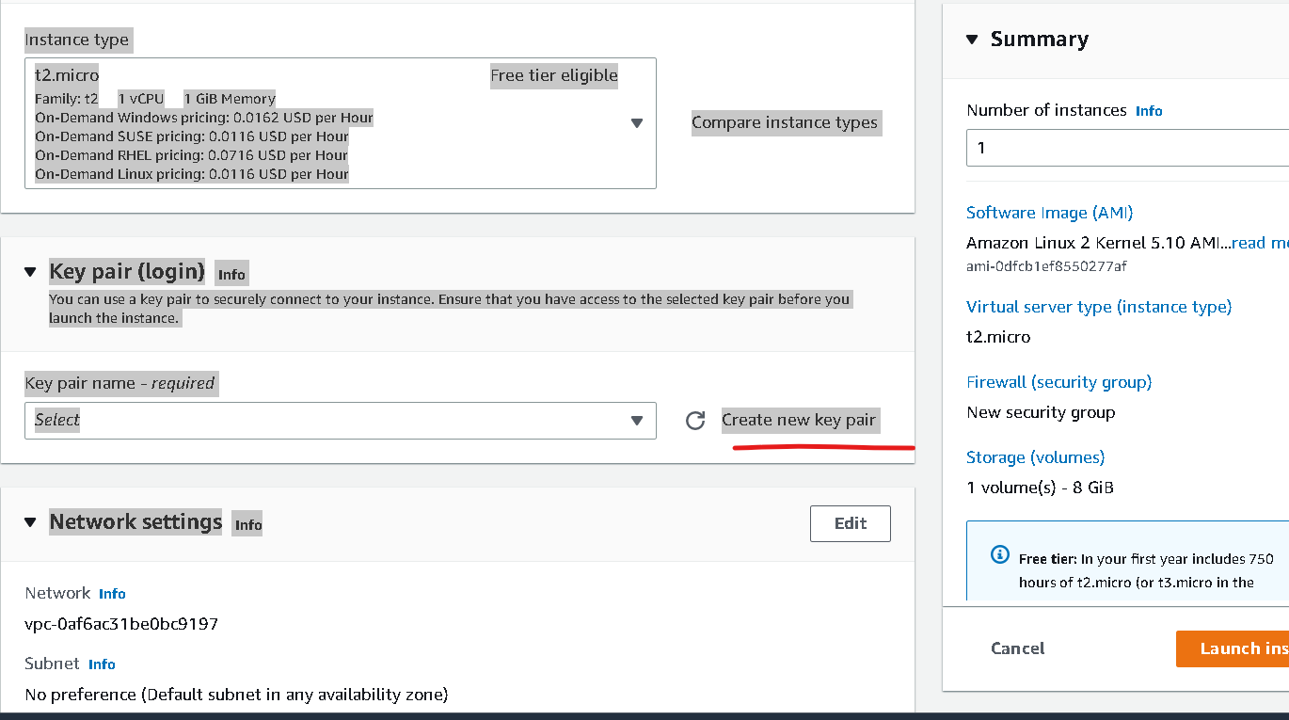
Click on create key

Slide 20
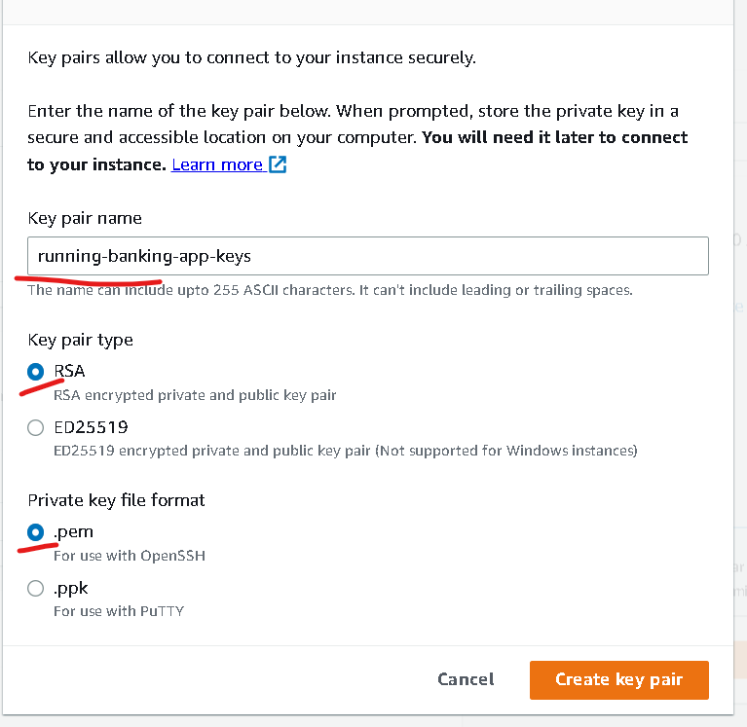
Create the key (please remember path of the file which help to connect to instance )
Keyname is phase2-keys
Private key file format
.pem
If client is SSH client you can create
In MAC or unix we can use normal terminal as SSH client but in window we have to use gitbash which support SSH client
.ppk : this for window with putty tool.

Slide 21
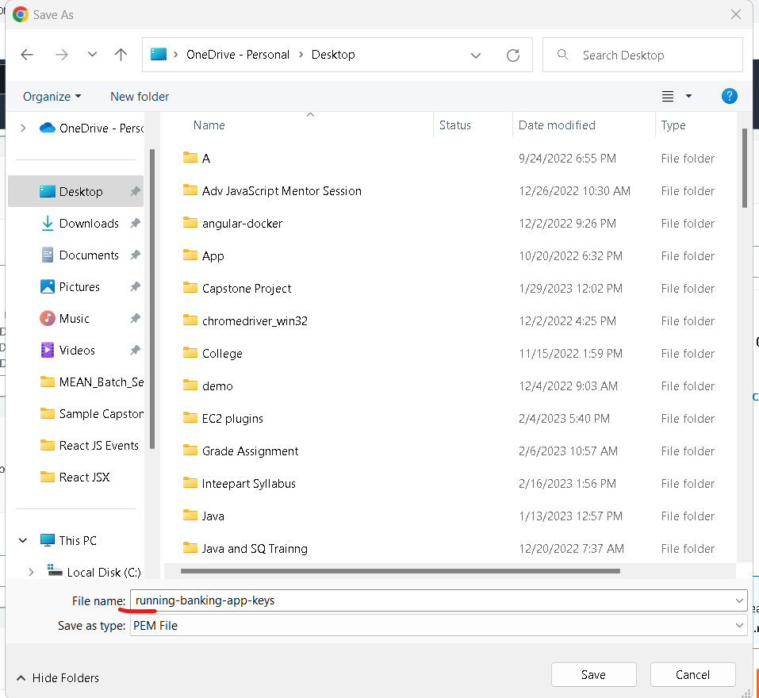

Slide 22
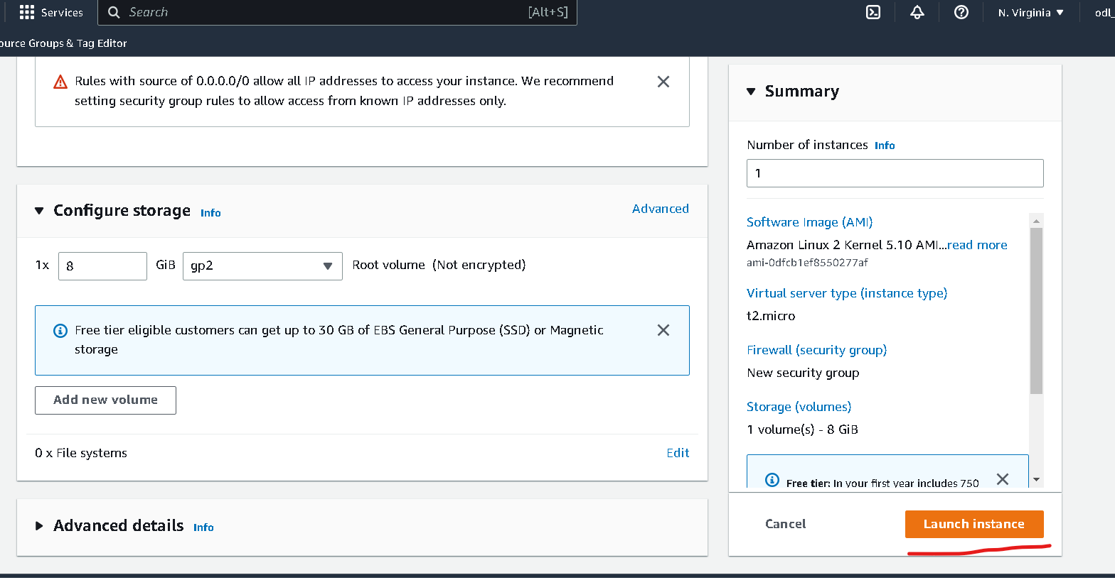
Other option are default don’t do any changes

Slide 23
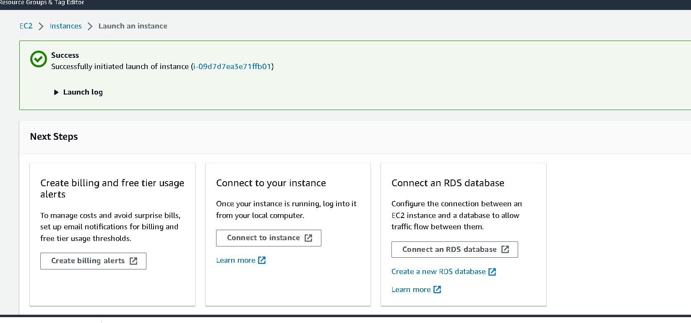

Slide 24
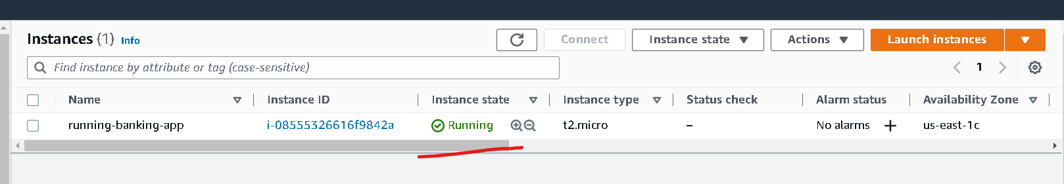
Wait for few minutes to instance to run

Slide 25
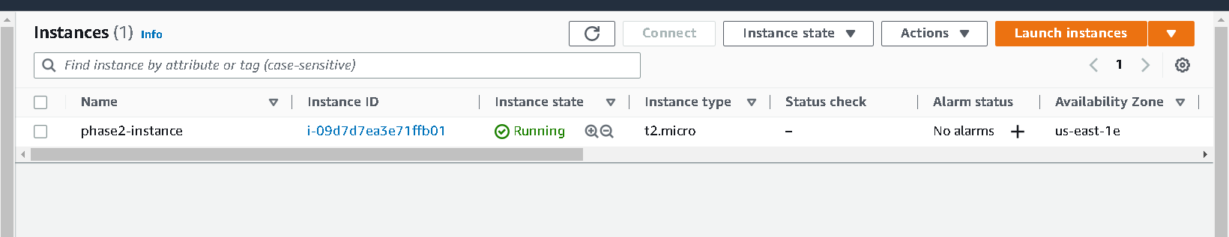
Once instance up

Slide 26
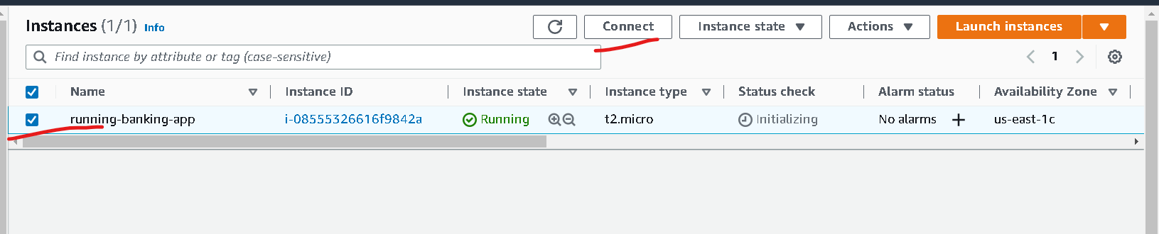
Now click on check box of instance and click on connect

Slide 27
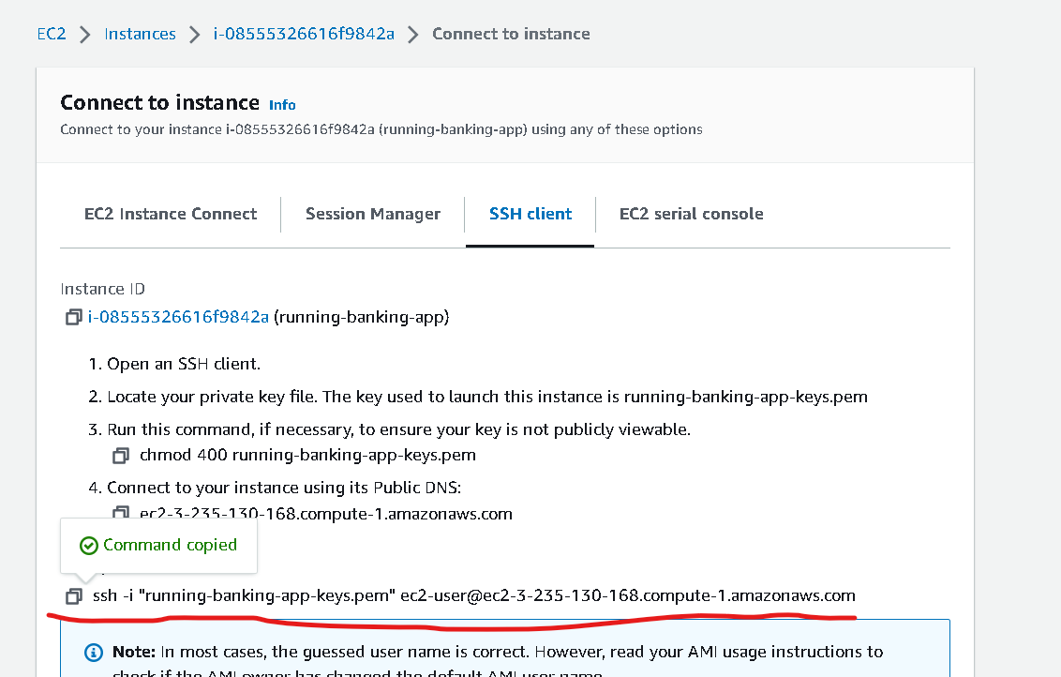
Now you have to copy and example code content which help to connect running instance through ssh client

Slide 28
Steps to connect instance
If you are connecting from window please using gitbash. Open gitbash in the location where .pem file present
If you are connection from unix or mac. Please open terminal in that location where .pem file present.

Slide 29
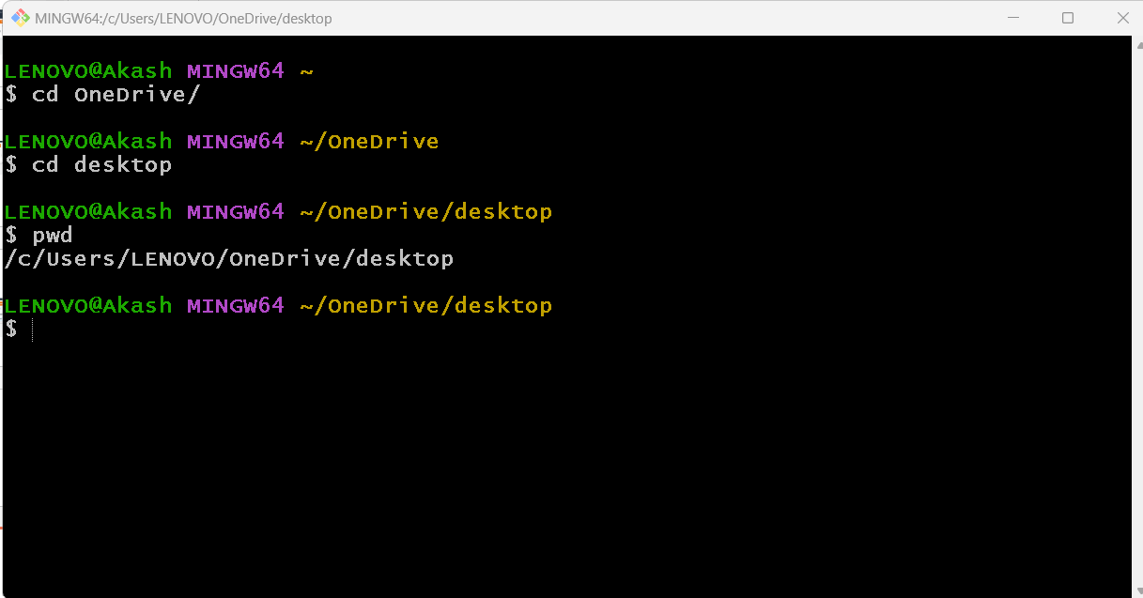
My file present in desktop so I have point to desktop using gitbash

Slide 30
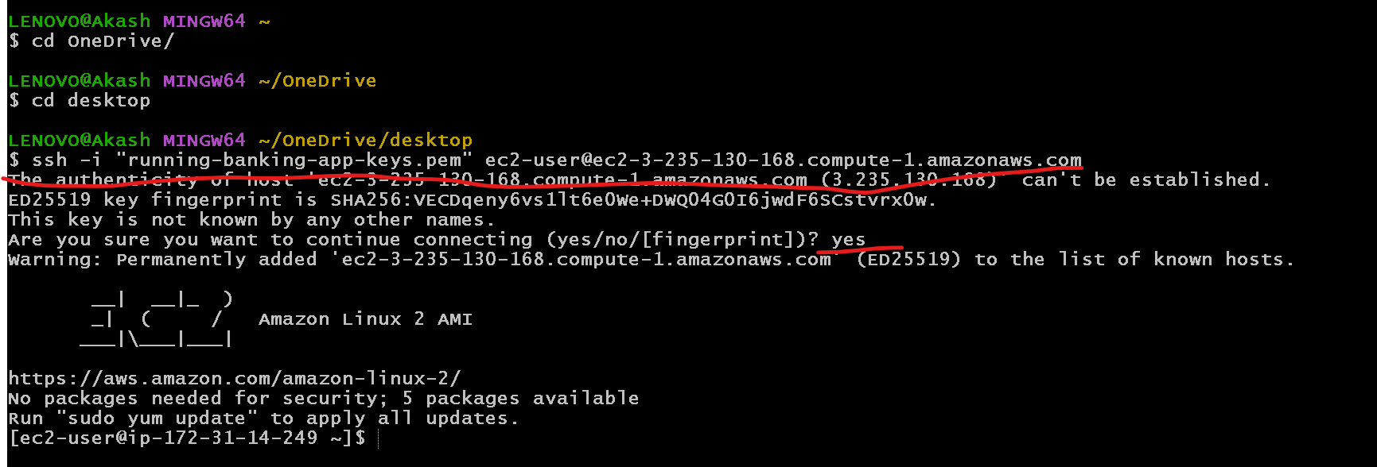
Please paste that command to connect this terminal to aws instance

Slide 31
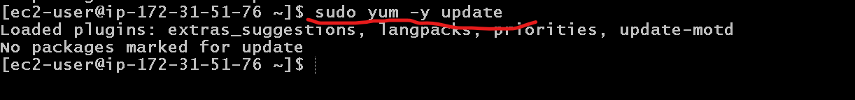
We need to update instance using command as
sudo yum –y update

Slide 32
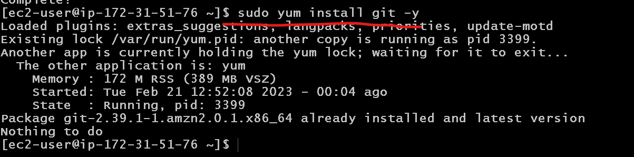
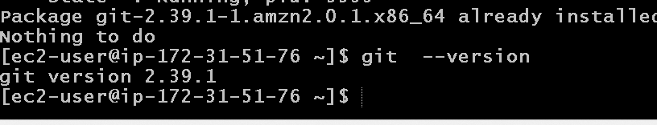
Now we need to instance git in ec2 instance
sudo yum install git –y

Slide 33
Now we will install the docker in EC2 instance
This command is use to install the docker
sudo yum -y install docker
This command is use to start the docker
sudo service docker start
This command is use to verify docker details
sudo docker info
This command is use to verify docker version and docker images
sudo doker –version
sudo docker images

Slide 34
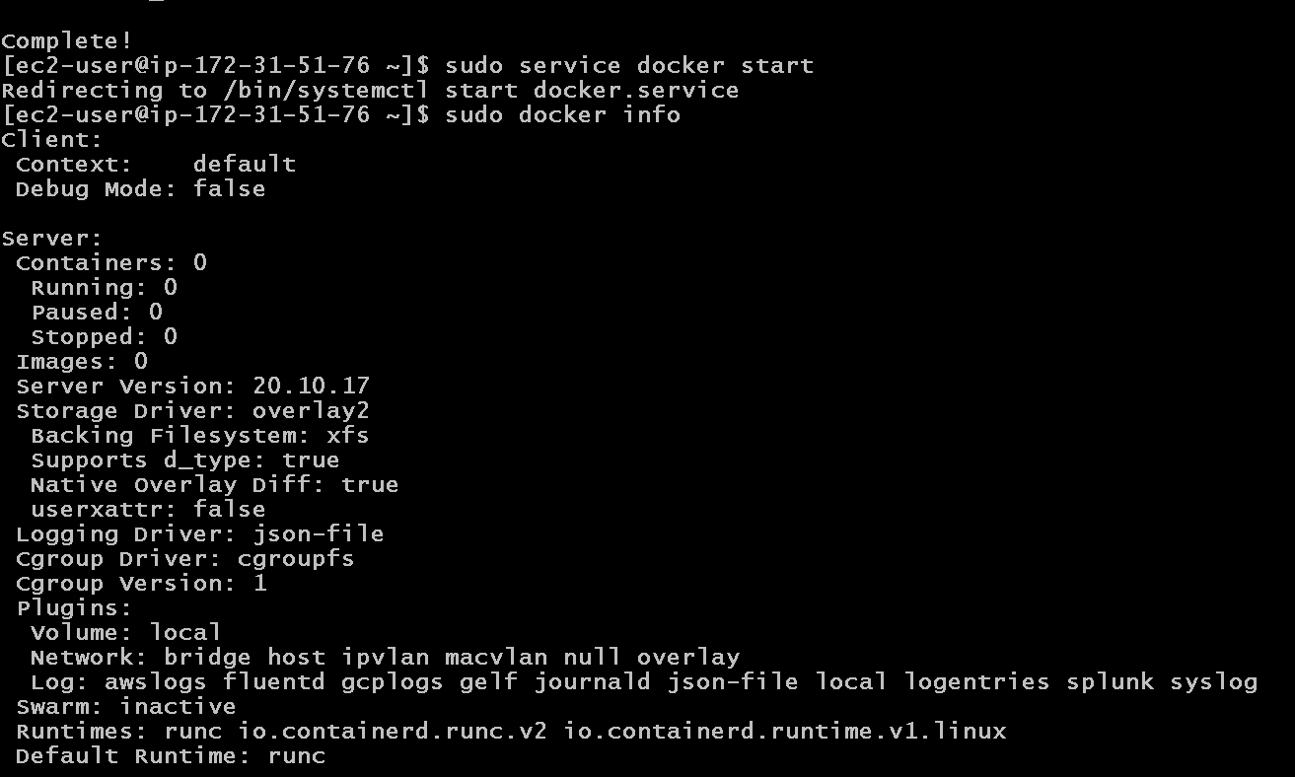

Slide 35
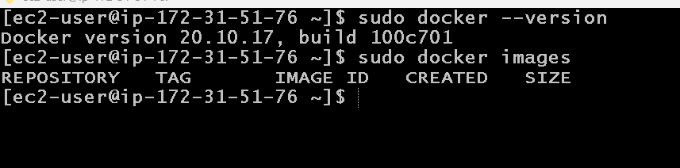

Slide 36
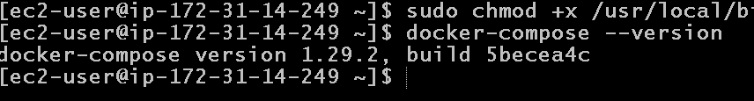
We need to install docker-compose
Because in EC2 instance by default docker-compose command not available
Below 2 command execute
sudo curl -L "https://github.com/docker/compose/releases/download/1.29.2/docker-compose-$(uname -s)-$(uname -m)" -o /usr/local/bin/docker-compose
sudo chmod +x /usr/local/bin/docker-compose

Slide 37
Now we will install Jenkin CI and CD tool in EC2 instance
Before Jenkin installation we need to install Java 11 because Jenkin is base upon the Java 11.
sudo amazon-linux-extras install java-openjdk11
It will ask you y/n :please enter y
java --version

Slide 38
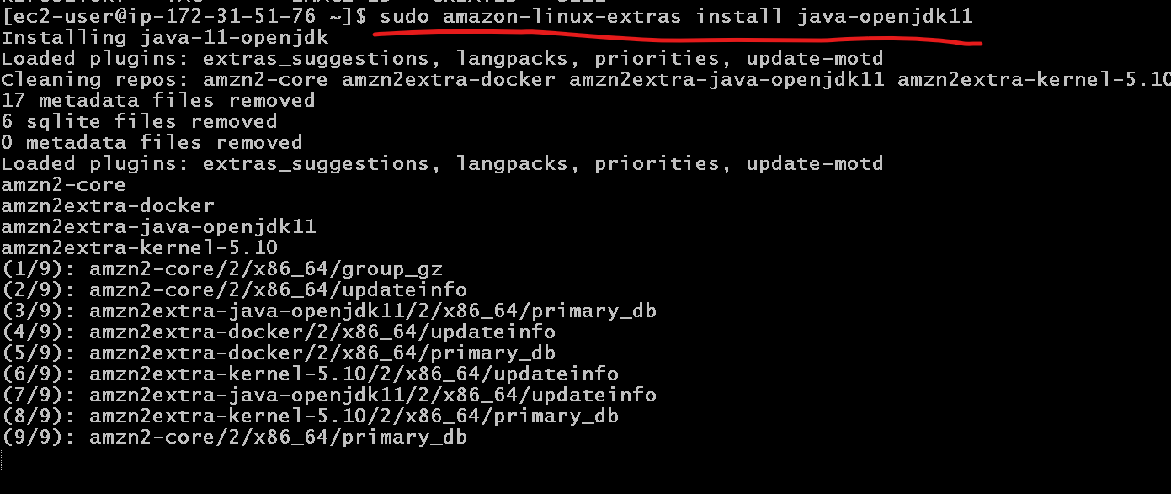

Slide 39
Now we will install jenkin
Pull jenkin software
sudo wget -O /etc/yum.repos.d/jenkins.repo https://pkg.jenkins.io/redhat/jenkins.repo
Extract that software
sudo rpm --import https://pkg.jenkins.io/redhat-stable/jenkins.io.key
Now install this software
sudo yum install jenkins (please enter y) if it ask.
Then we need to start the service
sudo service jenkins start
To check the service status
sudo systemctl status jenkins

Slide 40
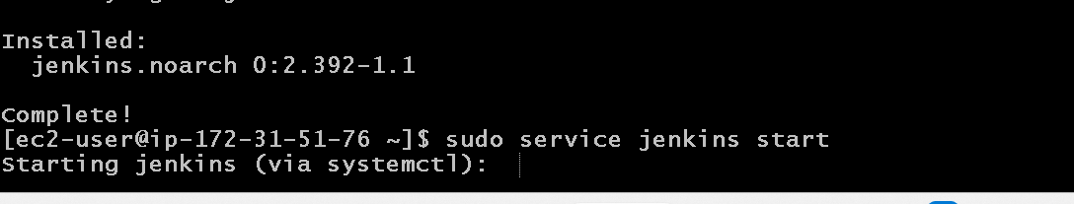
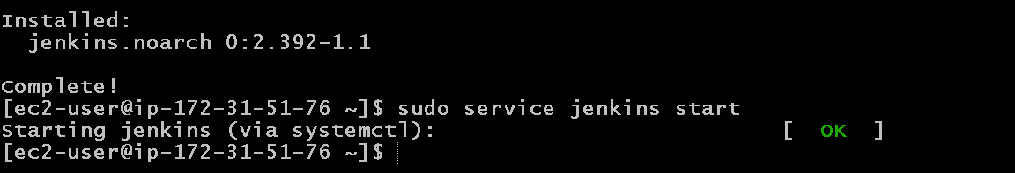
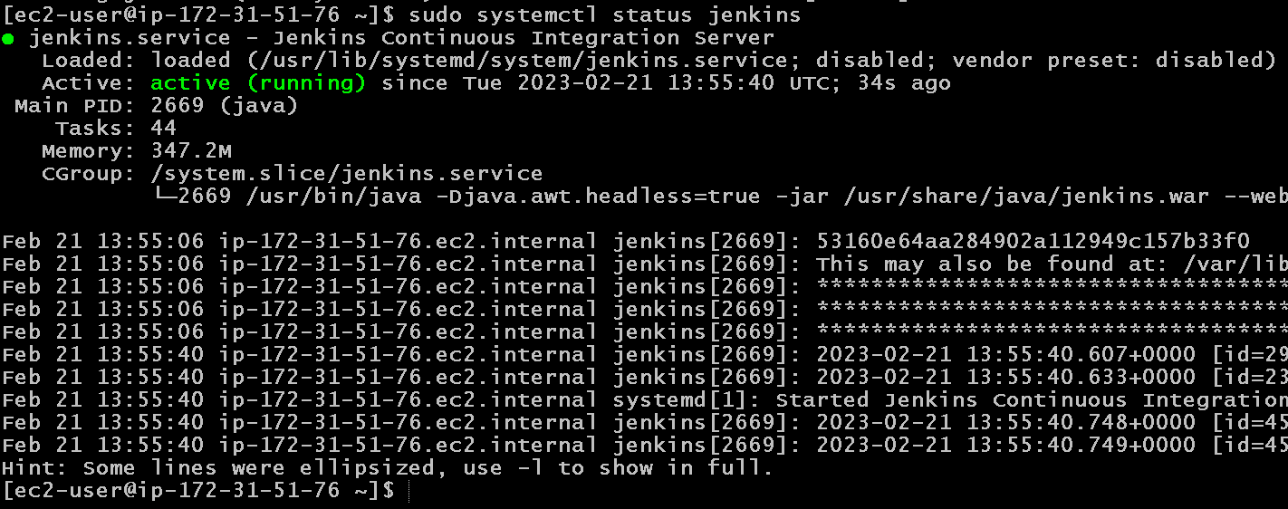

Slide 41
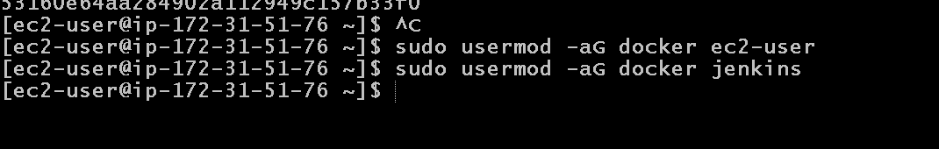
Now we will add usermod Jenkin and docker
sudo usermod -aG docker jenkins
sudo usermod -aG docker ec2-user

Slide 42
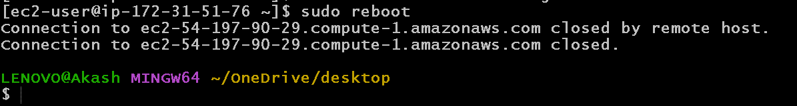
To get the effect please reboot ec2 instance
sudo reboot
After reboot please wait few minutes then reconnect

Slide 43
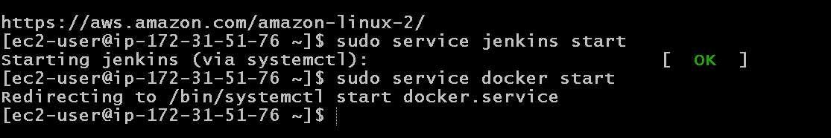
After re-connected to ec2 instane
We need to start Docker and Jenkin once again
sudo service docker start
sudo service jenkins start

Slide 44
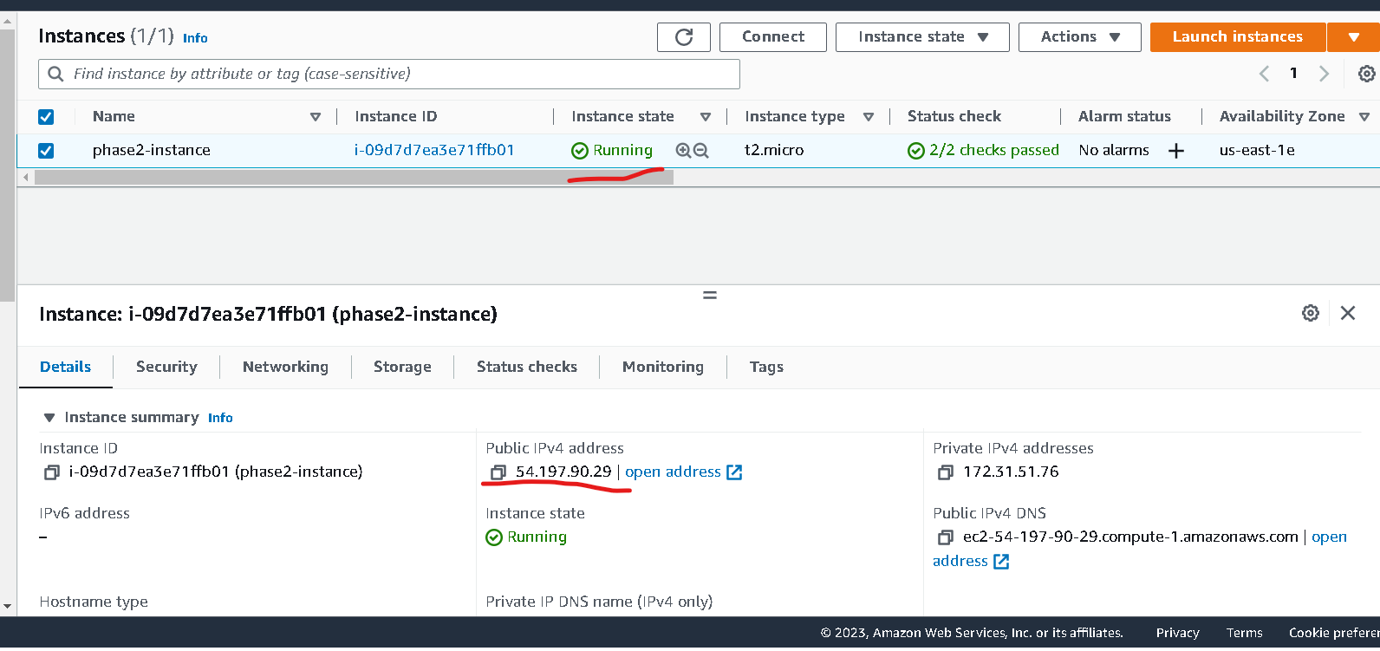
Check ec2-instance ip address

Slide 45
Application running on port number
Jenkin running on port number 8080 (default port number).
Nginx server running on port number 80( default port number).
So now we need to open both port number in inbound.

Slide 46
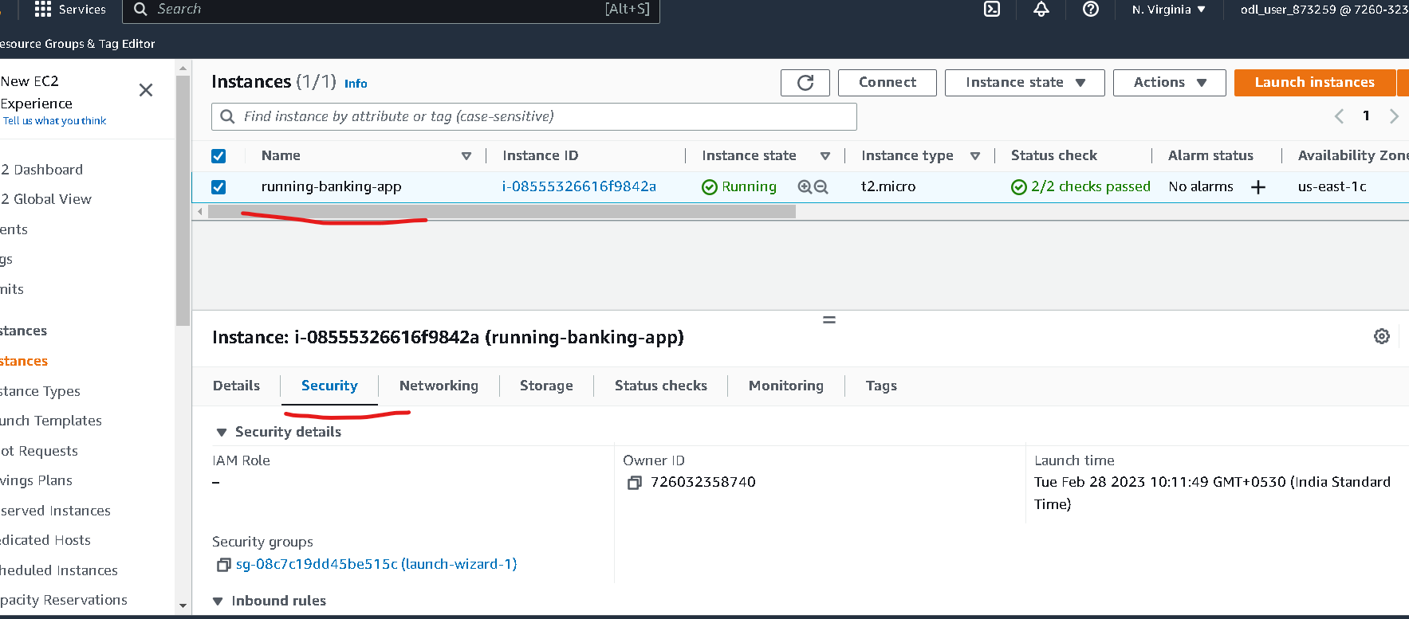
Select the security option

Slide 47
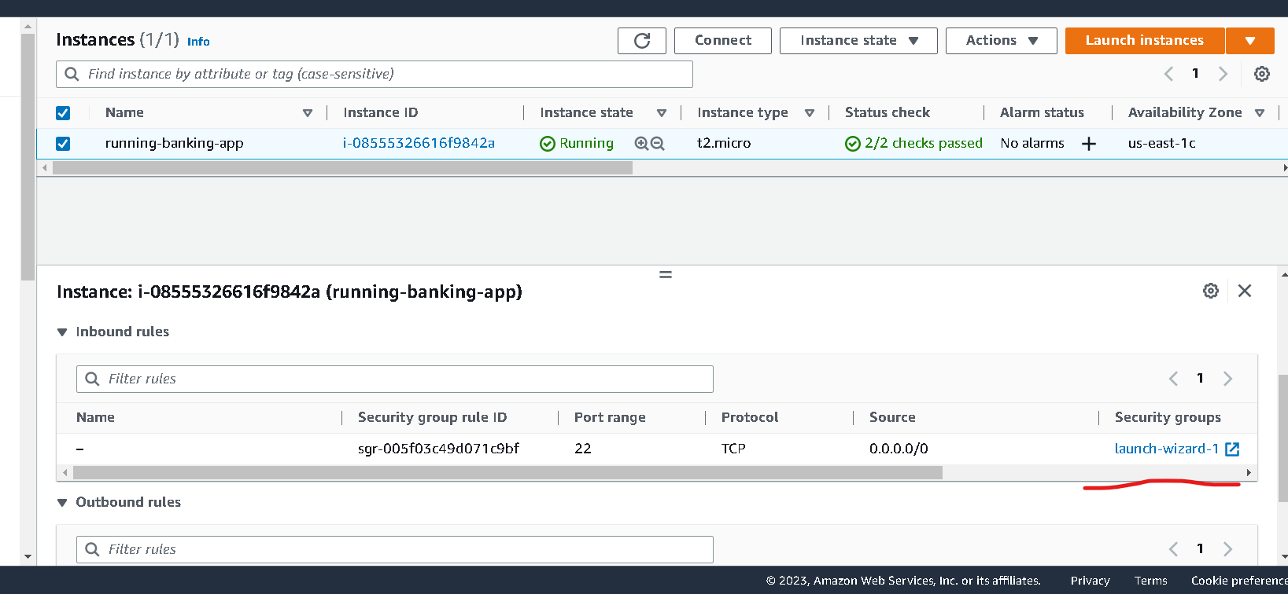
Search security launch wizard

Slide 48
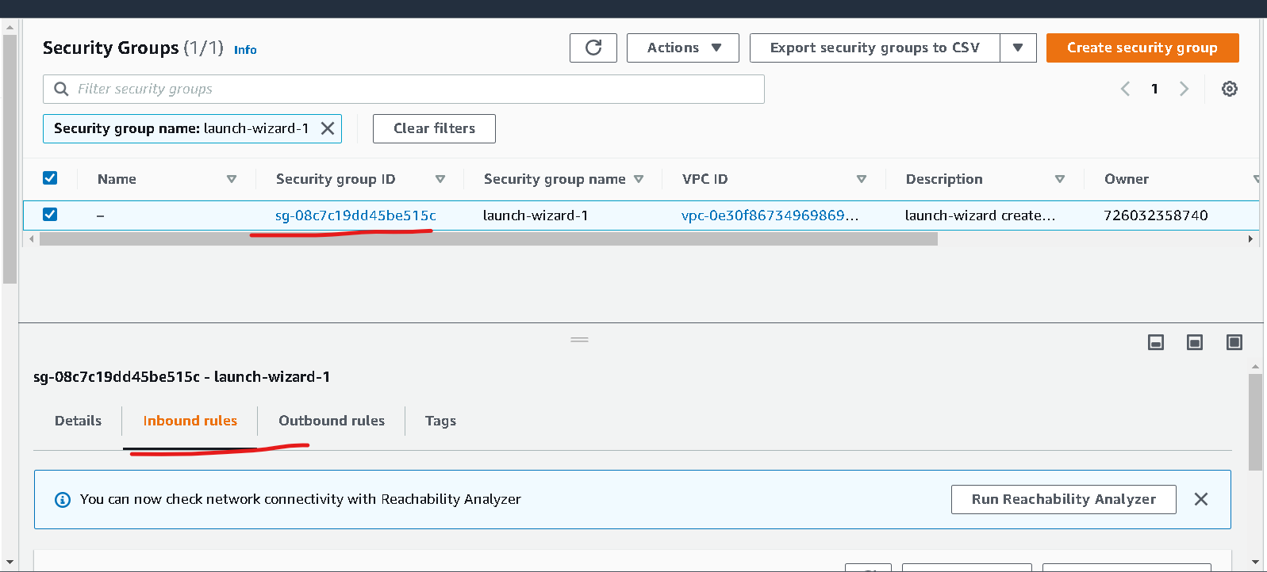
Once you click on launch wizard it open another tab in browser.

Slide 49
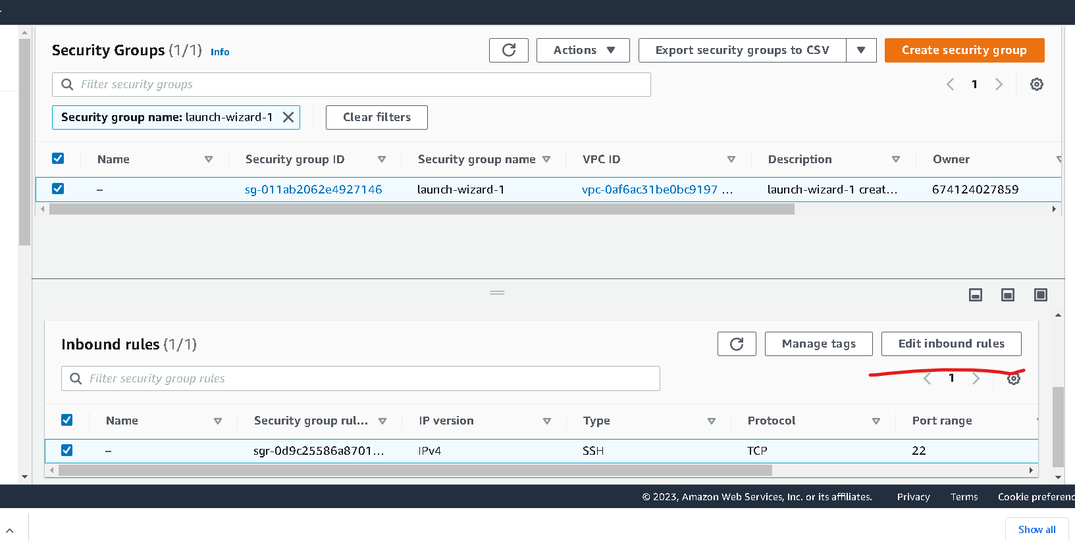
Search edit inbound rules

Slide 50
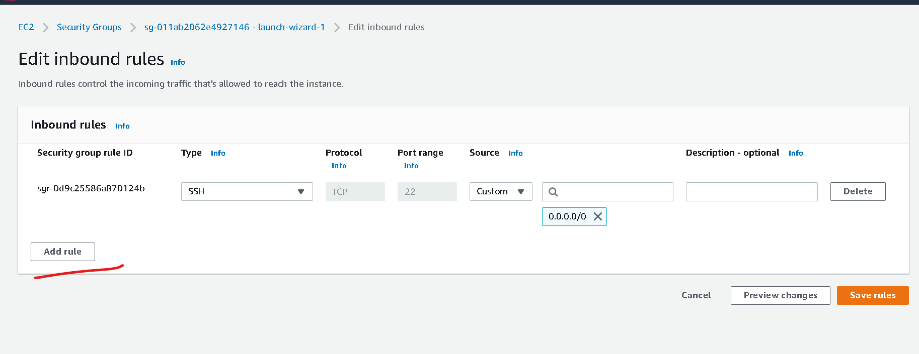

Slide 51
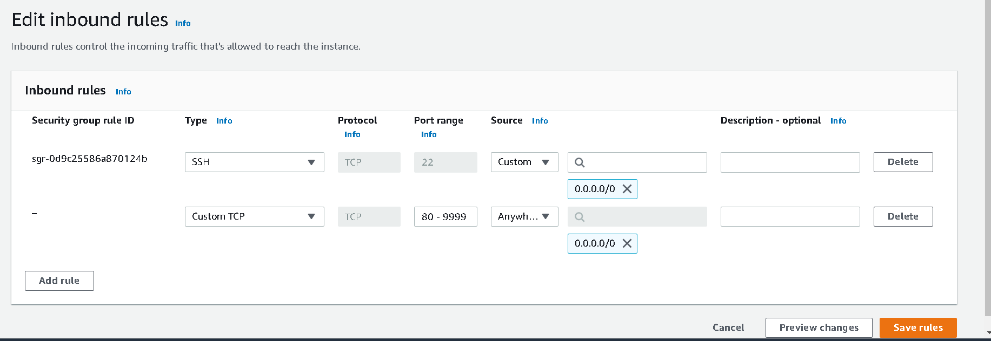
Click on add rule
Type must be : custom type
Protocol : TCP
Port range : 80-9999 ( means we can use any port number between range 80 to 9999)
Source : anywhere
Click on save rules

Slide 52
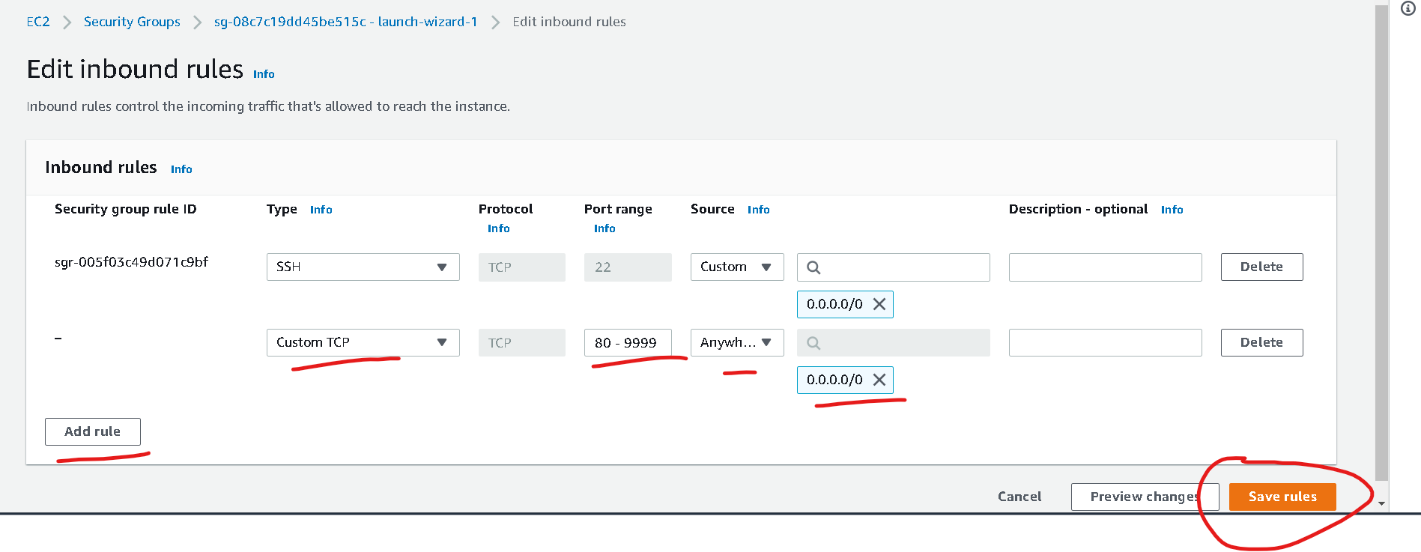
Check your ec2 instance ip address

Slide 53
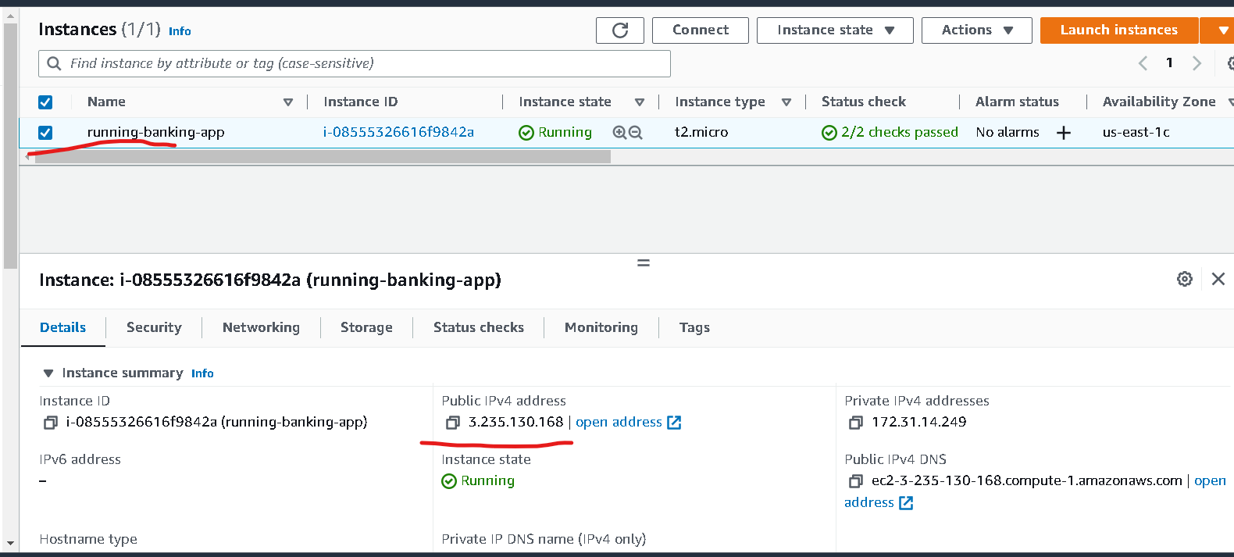
Instance details

Slide 54
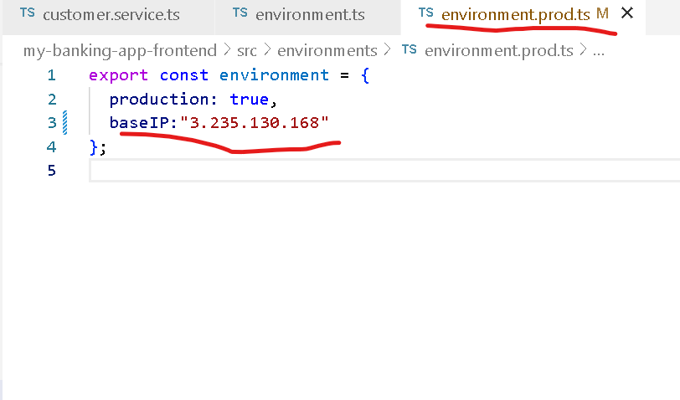
Now you have to do the changes in angular project.
in environment.prod.ts file

Slide 55
After done the changes in angular project
Re – build the angular project
Please move inside a angular project folder and run the command as ng build
and please push these changes in git hub account.

Slide 56
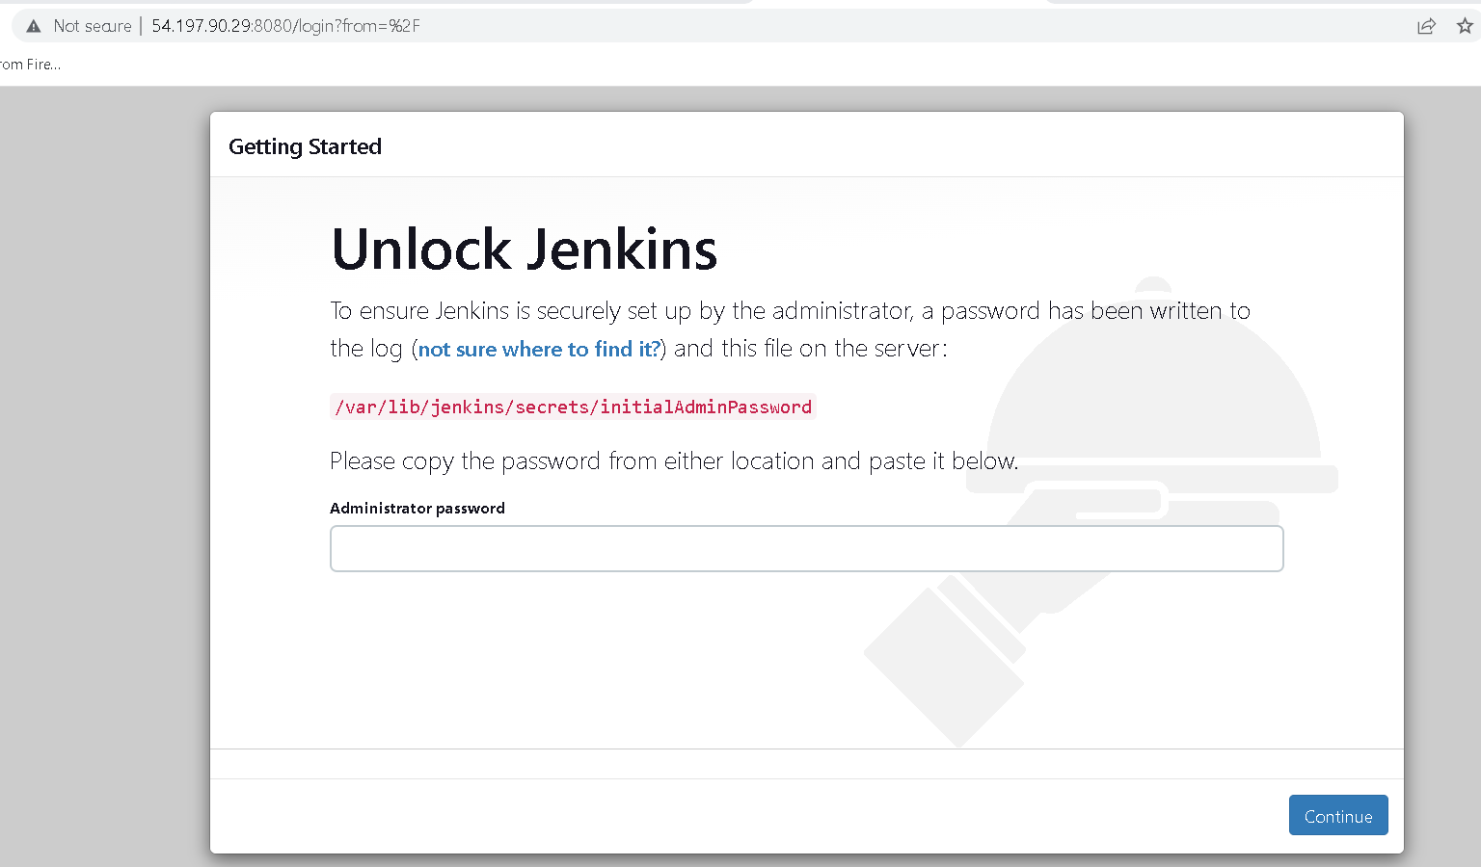
Now using IP address with port number 8080 check jenkin running or not.
For my ip address with http://3.235.130.168:8080/login?from=%2F

Slide 57

After running jenking
The default user name is :admin and password is random password generated by jenkin.
To get that password you need to run the command in ec2-instance terminal ie gitbash
sudo cat /var/lib/jenkins/secrets/initialAdminPassword

Slide 58

Paste this password

Slide 59

After password paste it will ask to install plugin. Please install suggested plugin

Slide 60

Wait to install all plugin

Slide 61

Now you need to create the account

Slide 62


Slide 63


Slide 64


Slide 65

Jenkin dashboard

Slide 66


Slide 67


Slide 68

From source code management you can provide git url

Slide 69

In build trigger you can provide when the project need to build

Slide 70

Before build you wan to set any build environment details you can set from here

Slide 71

In build you can write those command which help to build the project

Slide 72


Slide 73

After build you want to do any task that you can assign in post build

Slide 74

After all setting you have to save the job then click on build now

Slide 75

You can see out build result
If build success then we can see in green color else we will get red color

Slide 76

After click on green link

Slide 77

Now click on console output

Slide 78
Now we will create the Jenkin job
This job is responsible to
Here we are creating jenking pipeline job which is responsible to pull the project from git ie RunningCapstone project.
From git url as https://github.com/Kaleakash/RunningBankingApp.git
This pipeline is responsible to run docker-compose file which is present in git hub.
This file contains 3 images details run those images in EC2 instance
This file execute again and execute whenever we do changes in project and push the project git.
So we configure git hook with pipeline.

Slide 79
Please Jenkinsfile file
This file must be present in github which contains jenking pipeline details.

Slide 80

Click on new item

Slide 81


Slide 82

Trigger with github hook build whenever we do changes in github repository

Slide 83


Slide 84


Slide 85


Slide 86


Slide 87


Slide 88


Slide 89

Now we have to do the changes in Jenkins file in local machine or virtual machine

Slide 90

After changes done
After changes done please push these changes in git hub account.

Slide 91


Slide 92

After build you can verify build details

Slide 93

Now you have to verify the project
http://3.235.130.168/

Slide 94

Admin login with emailid as admin@gmaillcom and password is admin@123

Slide 95

Admin home page

Slide 96

Now we will signup for customer

Slide 97

After fill the account details

Slide 98


Slide 99

Login customer details : emailid : john@gmail.com and password : john@123

Slide 100

Customer home page

Slide 101

Customer view details

Slide 102
Do few transaction operation
Like
withdraw
deposit

Slide 103

View transactional details

Slide 104
Now you have to go github account
To configure github hook with jenkin account.

Slide 105


Slide 106


Slide 107

Click on addhook

Slide 108


Slide 109

Check configure or not
If you get green color then configure property or else some error generate we need to check setting properly.

Slide 110

Now we will do the changes
In index.compone.html page

Slide 111

Replace by Banker Online application

Slide 112
Re build the project
Real time build steps we write in pipeline but in Jenkin which is running on EC2 instance taking more time because we are using free tier ec2 instance so build steps we are doing in local machine and we are pushing complete build file in git hub account.

Slide 113


Slide 114


Slide 115

You can see build will execute automatically
The time will display ec2 instance os

Slide 116


